Slide 1
Patient Safety:
Generating and Using Evidence to Make Health Care Safer
Jeff Brady, MD, MPH
Director, Center for Quality Improvement and Patient Safety (CQuIPS)
Agency for Healthcare Research and Quality
Massachusetts Patient Safety Forum
Burlington, MA – April 7, 2014

Slide 2

Agenda
Producing and Using Evidence to Make Health Care Safer
Promoting Change in Health Care Delivery
  Focus on local capacity
Supporting Local Solutions and National Goals

Slide 3
AHRQ’s New Mission
To produce evidence to make health care safer, higher quality, more accessible, equitable, and affordable, and to work with HHS and other partners to make sure that the evidence is understood and used.
Notes:
As the only Agency with the sole mission of producing evidence to improve the delivery of health care services and health outcomes, providing evidence to guide the work of key HHS initiatives is a role that AHRQ is uniquely able to fulfill .

Slide 4
AHRQ Priority #2: Produce Evidence to Make Health Care Safer
Prevent Healthcare-Associated Infections
Accelerate Patient Safety Improvement in Hospitals
Reduce Harm Associated With Obstetrical Care
Accelerate Patient Safety Improvements in Nursing Homes
Improve Safety and Reduce Medical Liability
Notes:
Much of what CQUIPS is engaged in falls under Priority #2, which very closely follows the Agency’s new mission.
This work is very much aligned with the work the Agency traditionally has done in influencing policy and then helped to drive the change – particularly involving the delivery system.
(Lead-in to which slides will be shown that correspond with the five elements of Priority #2.)

Slide 5
Patient Safety Topics
Healthcare Acquired Conditions (HACs)
  Healthcare-associated infections (HAIs)
  Safe medication use
Patient safety practices
  HAC-specific (e.g., HAIs, falls, pressure ulcers, VTE, etc.)
  Teamwork in health care
  Care coordination
Patient and family engagement
Human and environmental factors
  Health care simulation
  Diagnostic performance
  Health care facility design
Patient safety and medical liability
Patient safety measurement (reporting, surveillance, data analysis)
Notes:
These topics represent a large portion of existing AHRQ work in this area;
In an effort to break these down:
Different types of Adverse Events
And approaches to preventing them – some are specific to the types of adverse events, and others are more general.
Some of our research is defined by the discipline or perspective, such as Human factors
and we have some Special topics, e.g., medical liability, which is a Presidential Initiative, but also happens to be a system problem.
Measurement

Slide 6
Patient Safety Grant Mechanisms
Discovery
Demonstration
Dissemination
R18
R13
R01
R03
R36
K08
K02
K01
Training/Career Development
K01, K02, K08 –
Research Career and
Mentorship
R36 – Health Services
Research
Dissertations
Health Services Research
R03 – Small Research
Grants
R01 – Large Research
Grants
R18 – Large Demonstration/
Dissemination Grants
(PIPS II, Simulation,
General)
Conferences
R13 – Small and Large
Conference Grants
Notes:
AHRQ’s Patient Safety Research Continuum spans from Discovery to Dissemination and Implementation.

Slide 7
Patient Safety Program: President’s FY 2015 Budget Request
$72.6 million for Patient Safety Research
  $34 million for HAI prevention
  $16.6 million for patient safety risks and harms
  $ 7 million for Patient Safety Organizations Program
$15 million for building on successes in hospital safety and extend safety improvement to other settings of care
  Primary care
  Nursing home care

Slide 8

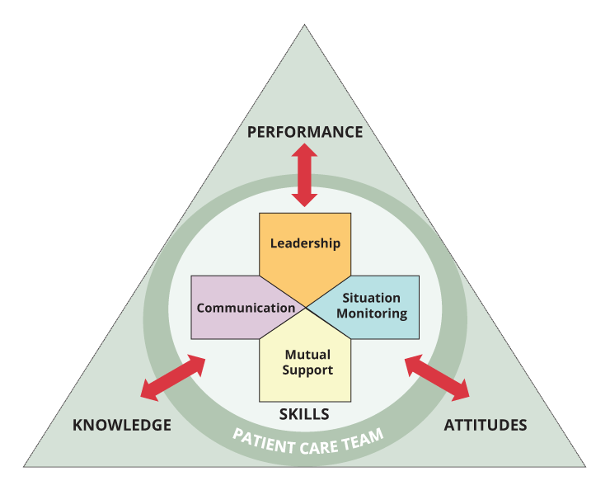
Examples of Successful Impact
Implemented in more than 1,000 hospital intensive care units, where CLABSIs have been reduced by 41 percent
Frontline caregivers in 100 neonatal intensive care units reduced central line-associated bloodstream infections in 8,400 newborns by 58 percent
More than 1,500 hospitals have implemented the training
More than 5,000 master trainers have trained more than 300,000 frontline health care professionals
TeamSTEPPS®
Notes:
As mentioned earlier, CUSP is one of the more targeted type of initiatives.
It is also an example of a project where the more foundational and specific elements came together.
TeamSTEPPS is an example of how ideas about dissemination are evolving.
What we see in the most successful cases is where it evolves from fairly straight-forward get-it-in-front-of-people dissemination, to dissemination as a component of implementation.
We’re doing both when evidence shows there is value in such an approach. And its hands-on technical assistance, where a function of certain tools is to lay out what the technical assistance is (it’s TA to accomplish these steps in the tools).
We can’t do this kind of technical assistance for every project. So, we’re trying to leverage the broader quality improvement community to make that transition from generating information, including information about how to use it, into full-scale implementation.
We’re also moving in the direction of technical assistance and evaluation, in terms of how a tool is being used and getting feedback.

Slide 9
AHRQ Healthcare-Associated Infections (HAIs) Prevention Program
AHRQ supports research and promotes wide-scale implementation of proven methods for preventing HAIs
Research projects focused on HAI prevention
Adaptation and Implementation of CUSP to reduce:
  CAUTI in hospitals
  SSI and other surgical complications in inpatient surgery
  SSI and other surgical complications in ambulatory surgery
  VAP
  CAUTI in long-term care/nursing homes
Notes:
AHRQ supports research and promotes wide-scale implementation of proven methods for preventing HAIs. Current activities include:
Expansion of a 12-State pilot project of CUSP for CAUTI in hospitals to a 4-year nationwide implementation effort (ends in 2015)
A 4-year nationwide project of CUSP to reduce SSI and other surgical complications in inpatient surgery (ends in 2015)
A 4-year nationwide project of CUSP to reduce SSI and other surgical complications in ambulatory surgery (ends in 2016)
Expansion of a 2-State pilot project of CUSP for VAP to a 3-year nationwide effort (ends in 2016)
A 3-year nationwide project of CUSP to reduce CAUTI in long-term care/nursing homes (ends in 2016)

Slide 10
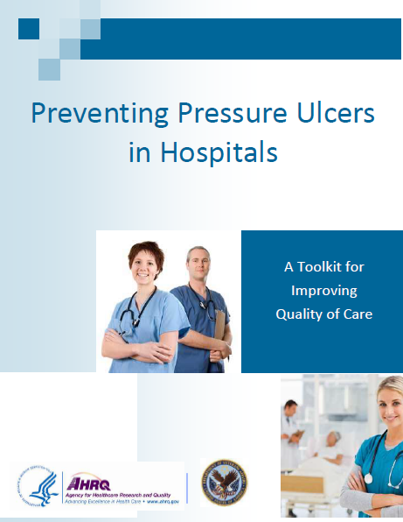
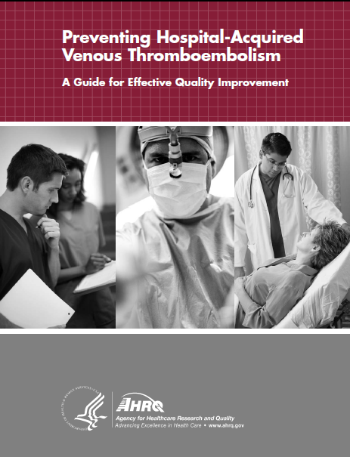
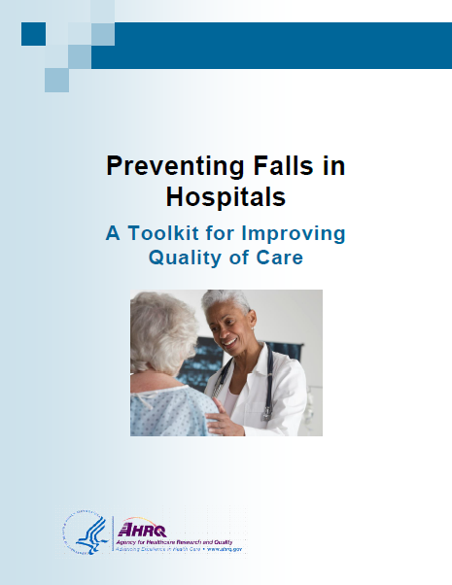
Accelerating Patient Safety Improvement in Hospitals
Falls prevention toolkit
  Helps hospitals overcome challenges associated with developing, implementing, and sustaining a fall prevention program
VTE toolkit
  Provides a framework to help quality improvement practitioners achieve important milestones in improving performance
Pressure ulcer toolkit
  Assists hospital staff in implementing effective pressure ulcer prevention practices through an interdisciplinary approach to care

Slide 11
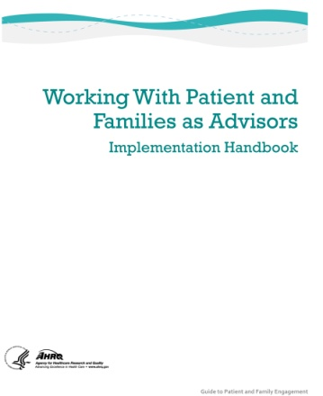
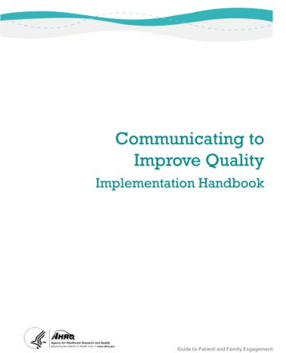
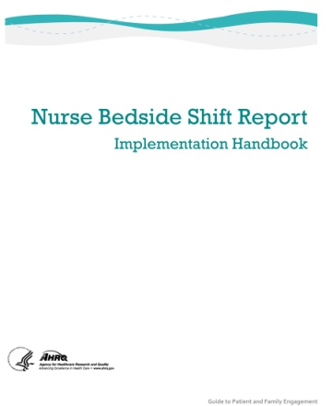
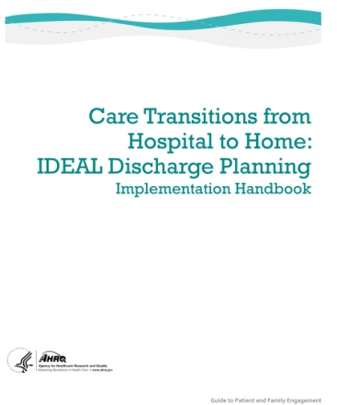
Guide to Patient and Family Engagement
Focuses on four strategies for promoting patient/family engagement in hospital safety and quality of care:
  Encourage patients and family members to participate as advisors
  Promote better communication among patients, family members, and health care professionals from the point of admission
  Implement safe continuity of care by keeping the patient and family informed through nurse bedside change-of-shift reports
  Engage patients and families in discharge planning throughout the hospital stay
Features handbooks and tools to implement each strategy
Included in the CUSP toolkit
http://wwPay Nune and drop off signed tax return documentPay Nune and drop off signed tax return documentPay Nune and drop off signed tax return documentw.ahrq.gov/professionals/systems/hospital/engagingfamilies/patfamilyengageguide/index.html

Slide 12
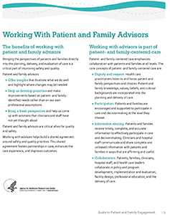

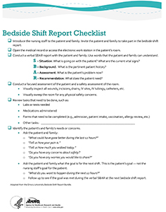
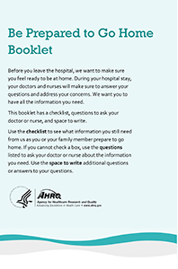
Sample Tools for Patients/Family Members and Clinicians
  Strategy 1: Encourage patients and family members to participate as advisors
Become a Patient and Family Advisor: Working Together to Help Improve Our Hospital (Brochure for patients/families)
Working With Patient and Family Advisors (Handout for clinicians)
  Strategy 2: Promote better communication among patients, family members, and health care professionals
Tips for Being a Partner in Your Care (Brochure for patients/families)
Communication Competencies for Clinicians (Handout for clinicians)
  Strategy 3: Keep patients and families informed through nurse bedside change-of-shift reports
Nurse Bedside Shift Report: What is it? How can you get involved? (Handout for patients/families)
Bedside Shift Report (Checklist for clinicians)
  Strategy 4: Engage patients and families in discharge planning
Be Prepared to Go Home (Booklet for patients/families)
Improving Discharge Outcomes with Patients and Families (Handout for clinicians)

Slide 13

Reducing Harm Associated With Obstetrical Care
Safety Program for Perinatal Care*
  Goals:
    To reduce maternal and neonatal adverse events
    Improve patient safety, team communication
    Improve quality of care within labor and delivery units
  Key elements:
    CUSP framework
    TeamSTEPPS® baseline
    In situ simulation
    Customizable toolkit
  Workgroup of Federal partners
*Currently in Pilot Testing

Slide 14
Patient Safety & Medical Liability Research Program
Part of the HHS patient safety and medical liability initiative. Seven demonstration grants across the Nation, four primary goals:
  Put patient safety first and work to reduce preventable injuries
  Foster better communication between doctors and their patients
  Ensure patients are compensated in a fair and timely manner while reducing frivolous lawsuits
  Reduce liability premiums
“This new research is the largest government investment connecting medical liability to quality and aims to improve the overall quality of health care.”
HHS Secretary
Kathleen Sebelius
June 11, 2010
http://www.ahrq.gov/qual/liability

Slide 15

AHRQ’s Communication &
Resolution Program Toolkit
The toolkit will be designed around a series of core principles:
  Adverse event reporting
  Communication & disclosure (i.e., full disclosure, apology & rapid remediation following an adverse event)
  Care for the caregiver
  Process improvement
Implementation will be customized for each hospital based on the results of a gap analysis

Slide 16
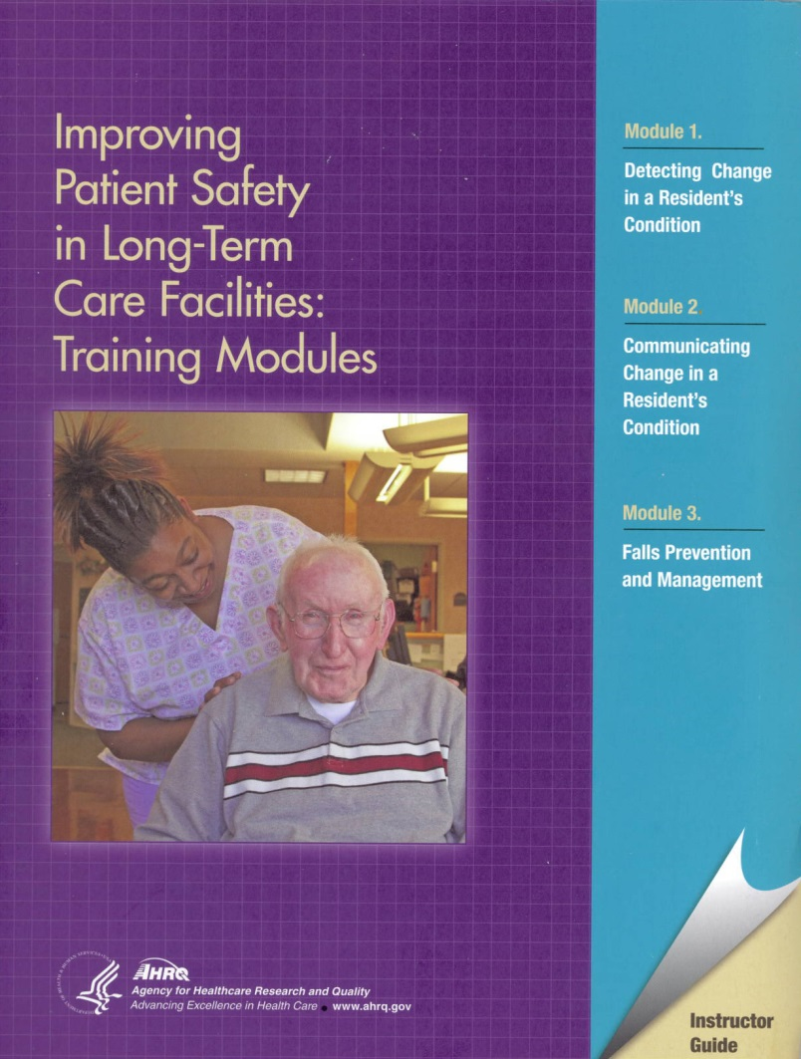
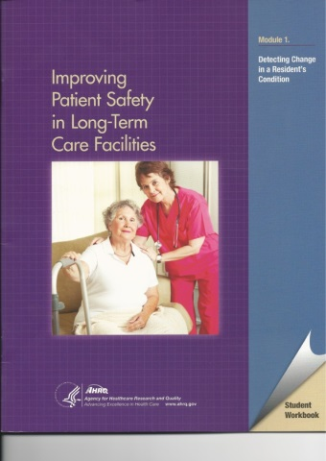
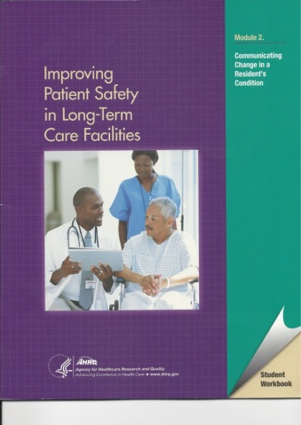
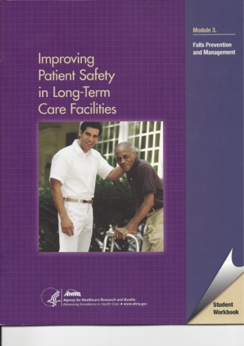
Accelerating Patient Safety Improvements in Nursing Homes
Intended for training front-line personnel in nursing homes and other long-term care facilities
Instructor guide and student workbooks are organized into three modules:
  Detecting Change in a Resident’s Condition
  Communicating Change in a Resident’s Condition
  Falls Prevention and Management
Nearly 3,000 downloads since October 2012

Slide 17
On-Time Pressure Ulcer Prevention Program
Uses health IT to improve care at the point of delivery through clinical decision support (CDS)
CDS reports summarize real-time information from multiple sources, enabling early intervention to reduce pressure ulcer formation risk
New research* found that implementation of the program led to a 59 percent reduction in the incidence of pressure ulcers per 100 nursing home residents per month
Lauren EW, Spector, WD, et al. “Evaluation of AHRQ’s On-Time Pressure Ulcer Prevention Program.” Medical Care March 2014
Notes:
Assuming 2.6 pressure ulcers avoided per month, the 59 percent reduction implies approximately $20,880 per month in cost savings in nursing homes with 100 residents

Slide 18
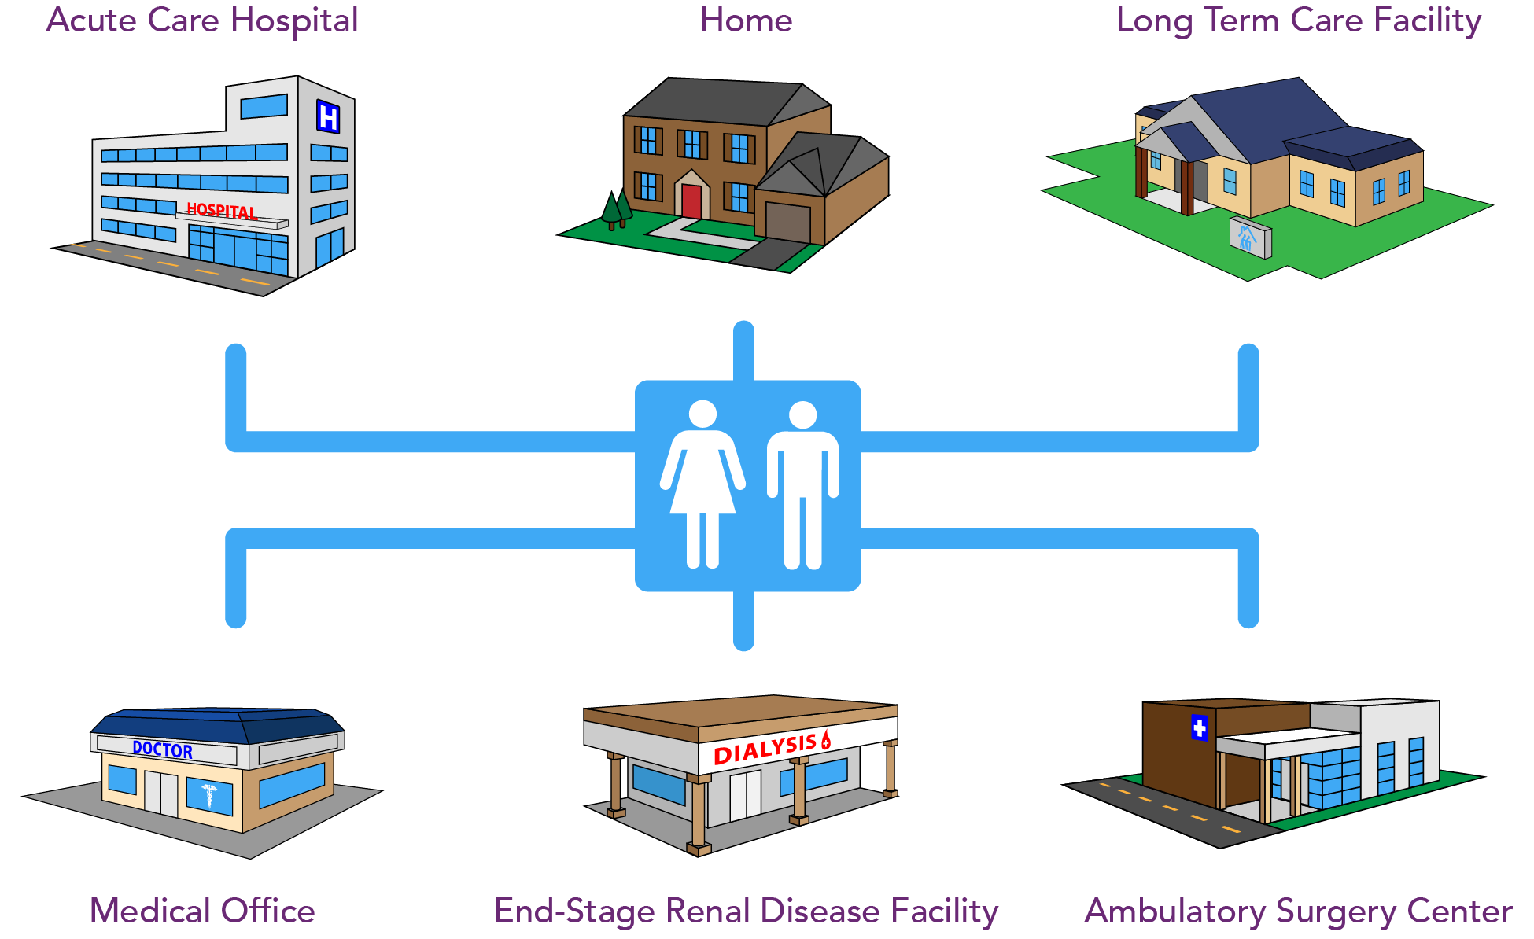
Extending Patient Safety to
All Health Care Settings

Slide 19
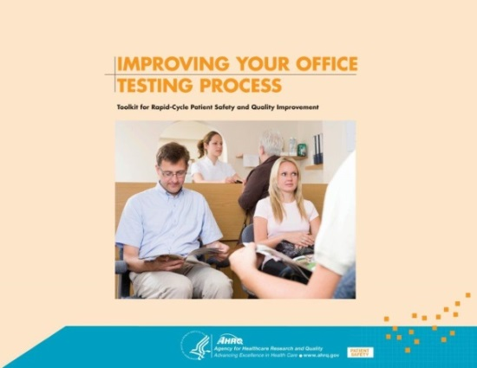
Toolkit for Rapid-Cycle Patient Safety and Quality Improvement
Will help medical offices assess and improve the process they use to manage patient testing and follow up
Includes surveys, survey scoring sheets, and patient handouts:
  Surveys of office readiness, testing processes, and patient engagement (English and Spanish)
  Tools for planning, chart audit, and electronic health record evaluation
  A patient handout (English and Spanish)
Users can pick and choose among these surveys and tools to select the ones that apply to their office

Slide 20
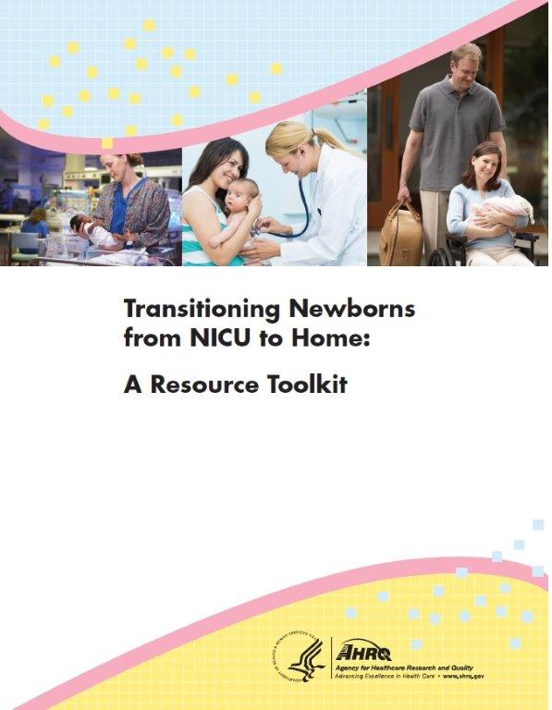
Transitioning Newborns From NICU to Home: A Resource Toolkit
Online toolkit can help coordinate care from the NICU to home
Outlines how to create a Health Coach Program to facilitate transitions
Includes nearly 30 clinical fact sheets on common issues faced by caregivers of premature babies
Customizable to meet individual family needs
www.ahrq.gov/nicutoolkit

Slide 21
Generating Evidence to Inform Practice & Policy and Support Implementation
Evidence and Tools for Implementation
Evidence to Inform
Practice & Policy
AHRQ
AHRQ
Notes:
AHRQ is not in the business of making policy.
One of our primary goals is to help to get to the point where they’re delivering quality care, so we try to do whatever we can to help them get there and policy alone is often not the solution.
We’re developing the evidence to inform policy and then we’re developing the tools to help make sure the evidence is used – to help people meet the intent of policy.

Slide 22
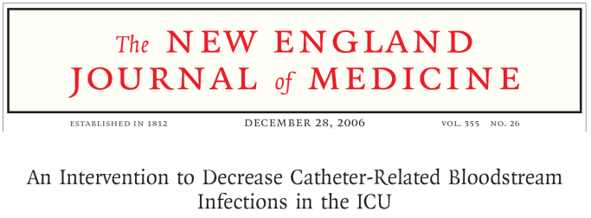
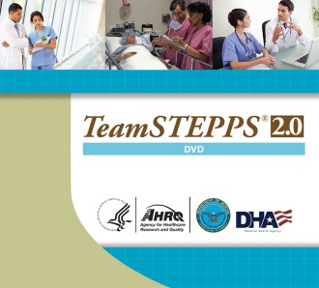
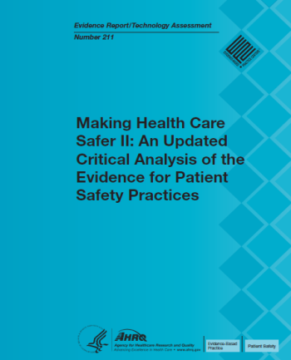
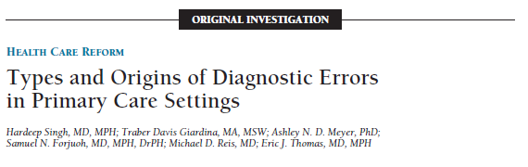

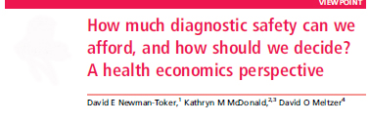
Generating Evidence to Inform Practice & Policy and Support Implementation
Evidence to Inform
Practice & Policy
Evidence and Tools for Implementation
Notes:
Expanding on the previous slide, this provides some examples of what would be evidence that informs, and evidence and tools for implementation.
We do work that could be called foundational, or more general in nature. One example that comes to mind is TeamSTEPPS.
The idea with TeamSTEPPS is, if you improve teamwork and coordination by a health care team, it gives you the potential to positively impact many outcomes.
We recently introduced TeamSTEPPS 2.0, is a complete update and streamlining of the original program.
Our work also conducts projects with a more targeted focus, on issues and conditions such as Venous thromboembolism (VTE). The most successful project here is the Comprehensive Unit-Based Safety Program (more coming a few slides later).

Slide 23
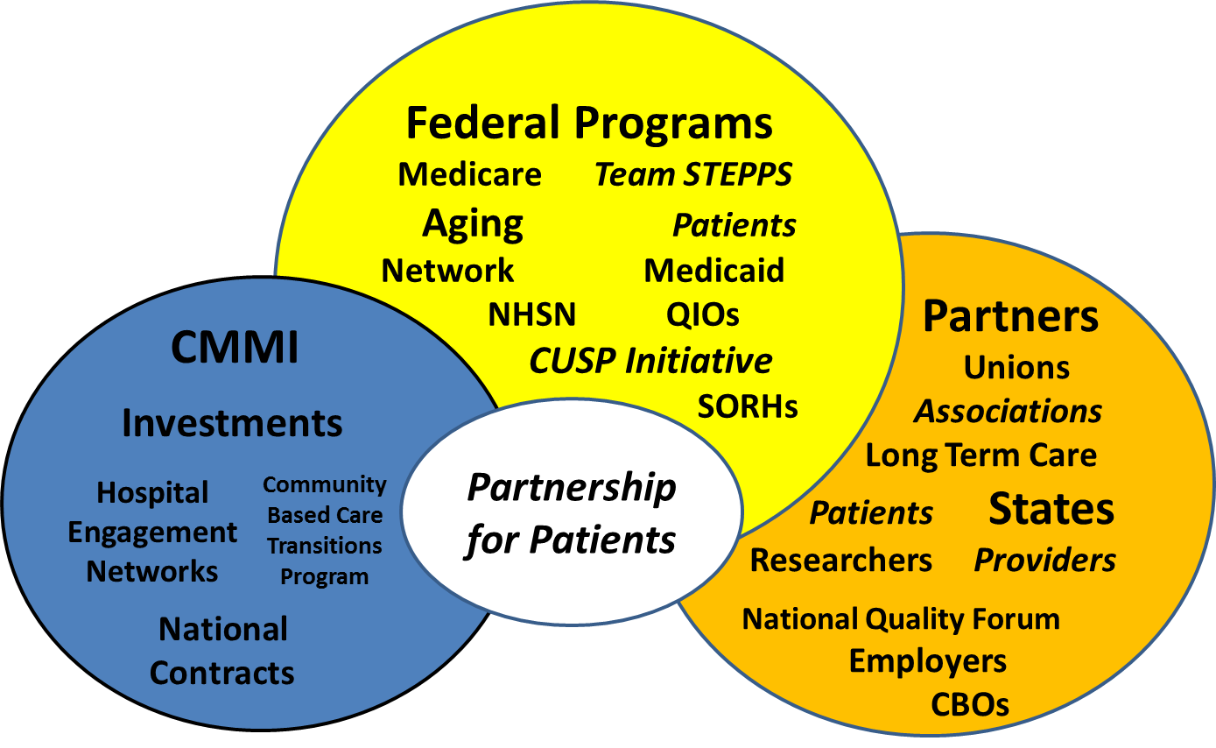
Partnership for Patients Achieves Results Through “3 Engines”

Slide 24

Partnership for Patients:
HHS Public-Private Initiative
40% decrease in instances of hospital patients acquiring preventable conditions, including:
  Central line-associated bloodstream infections
  Catheter-associated urinary tract infections
  Surgical site infections
  Ventilator-associated pneumonia
  Pressure ulcers
  Adverse drug events
  Venous thromboembolisms
  Injuries from falls
  Injuries from obstetrical adverse events
20% decrease in preventable readmissions due to complications during a transition from one care setting to another
www.healthcare.gov

Slide 25
Stages in Delivery System Improvement Research
Design
Pilot
Large-Scale
Implementation
Early Implementation
Low
Evaluation
Federal Agencies
State Agencies
Industry
Evaluation
High
Scale & Diversity
Evaluation

Slide 26
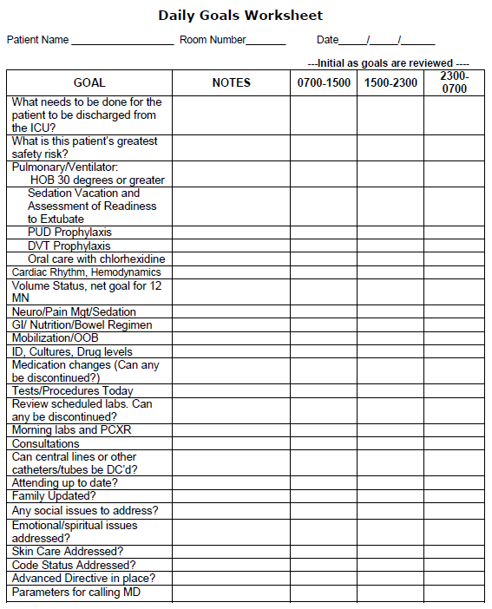
Local Solutions → National Goals
DAILY GOALS WORKSHEET
What is the patient’s greatest safety risk?
40% reduction in preventable hospital-acquired conditions
Can central lines or other catheters/tubes be DC’d?
Notes:
To a large extent, AHRQ’s support at the local level is what drives national goals (P4P, CUSP for CAUTI [the national priority goal of 10 percent]).
The way we get to these national goals is at the bedside.
CUSP’s Daily Goals sheet is a good example of bedside activities that lead to national goals.
Certain things are unique to individual adverse events and they need to be tailored. Others are not. The daily goals sheet is one of them.
Patients are not admitted for prevention of CLABSI or VTE. They’re admitted for something completely different.
As important as patient safety is, we’re lucky if it’s a secondary thought of providers. In all of the work we’re trying to do, we’re looking not only to raise the level of focus on safety, but do it in a way that is actually feasible for providers to have that focus without displacing what they’re working to achieve, which is many instances is saving someone’s life.
This is all about priorities and we don’t want safety to be a secondary priority, we want it to be integrated/entrenched into the culture to the extent that it’s just part of care.

Slide 27
Building Capacity to
Improve Safety and Quality
Capacity dimensions
  Time/Attention
  Knowledge
AHRQ supports expansion of both dimensions.
  Efficiency of safety & quality improvement
    Adapting standard, but flexible approaches to different settings, scenarios and threats to patient safety
  Training and technical assistance
Examples: TeamSTEPPS® and CUSP
Notes:
Capacity is a very important consideration that often is not given the prominence it deserves.
We’re asking providers on the front line to do something that they didn’t learn about in school.
Since these fundamental concepts for quality improvement aren’t taught, you have to establish that foundation before you can even get to using this type of knowledge to change workflow.
(Example: The blood pressure medication story.)

Slide 28
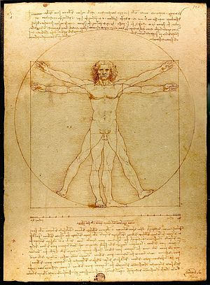
The Importance of Implementation
“I have been impressed with the urgency of doing.
Knowing is not enough;
we must apply.
Being willing is not enough; we must do.”
– Leonardo da Vinci

Slide 29
Thank You
http://www.ahrq.gov

